Slide 1
Chapter 2 – Stem cell

Slide 2
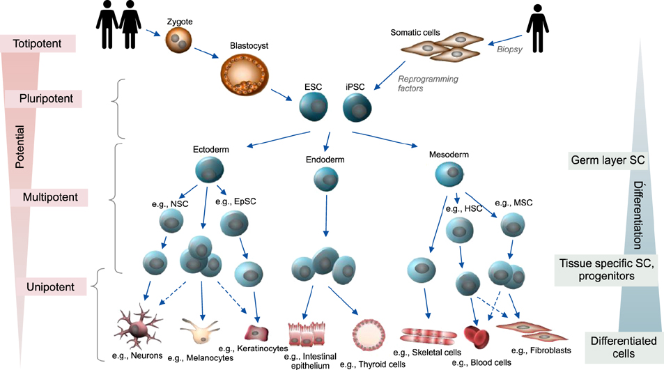
Notes:
Figure 2.1: Classical hierarchal model of stem cell differentiation. As pluri-potential goes down (left side), the cells undergo a greater degree of differentiation (right side). ESC: embryonic stem cell, iPSC: induced pluripotent stem cell, NSC: neural stem cell, EpSC: epidermal stem cell, HSC: hematopoietic stem cell, MSC: mesenchymal stem cell.
From Prodinger CM, Reichelt J, Bauer JW, and Laimer M (2017) Ann. Dermatology 29: 667-687.

Slide 3
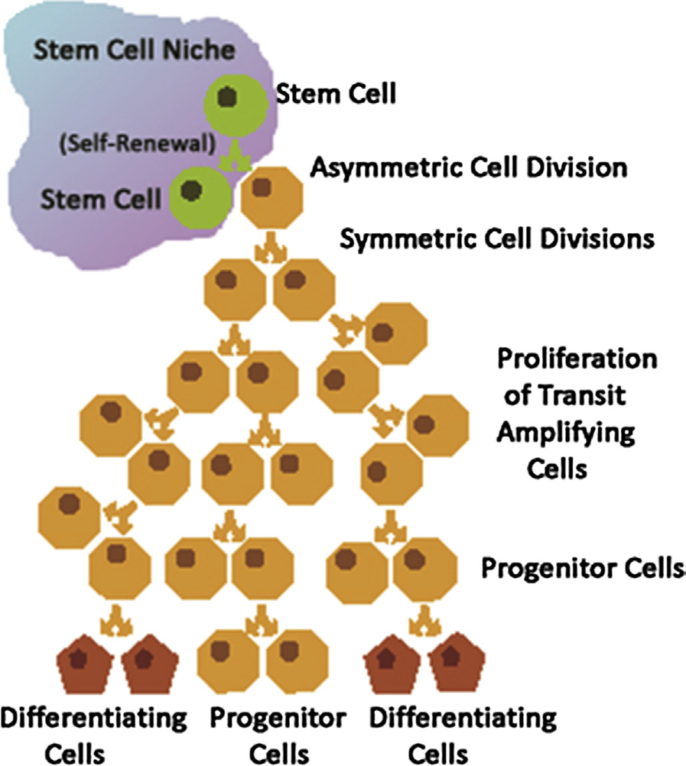
Notes:
Figure 2.2: Stem cell replication occurs in the stem cell niche and can be symmetrical or asymmetrical, and the most rapidly dividing cells are the transit amplifying cells. A few progenitor cells may exist among the non-dividing differentiated cells in the adult tissue.

Slide 4
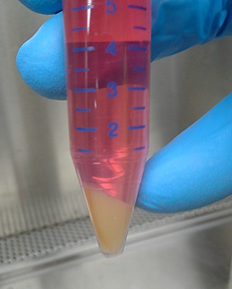
Notes:
Figure 2.3: Proliferation of stem cells.

Slide 5
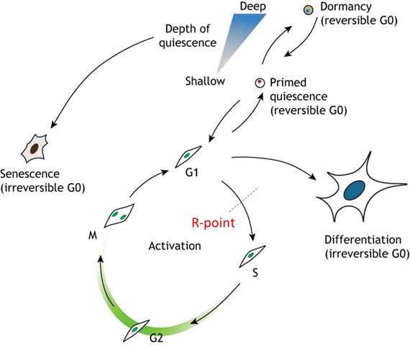
Notes:
Figure 2.4: Stem cell quiescence and the cell cycle.
From Stem cell quiescence: the challenging path to activation, Urban and Cheung, 2021, Development 2021;148: dev165084.

Slide 6
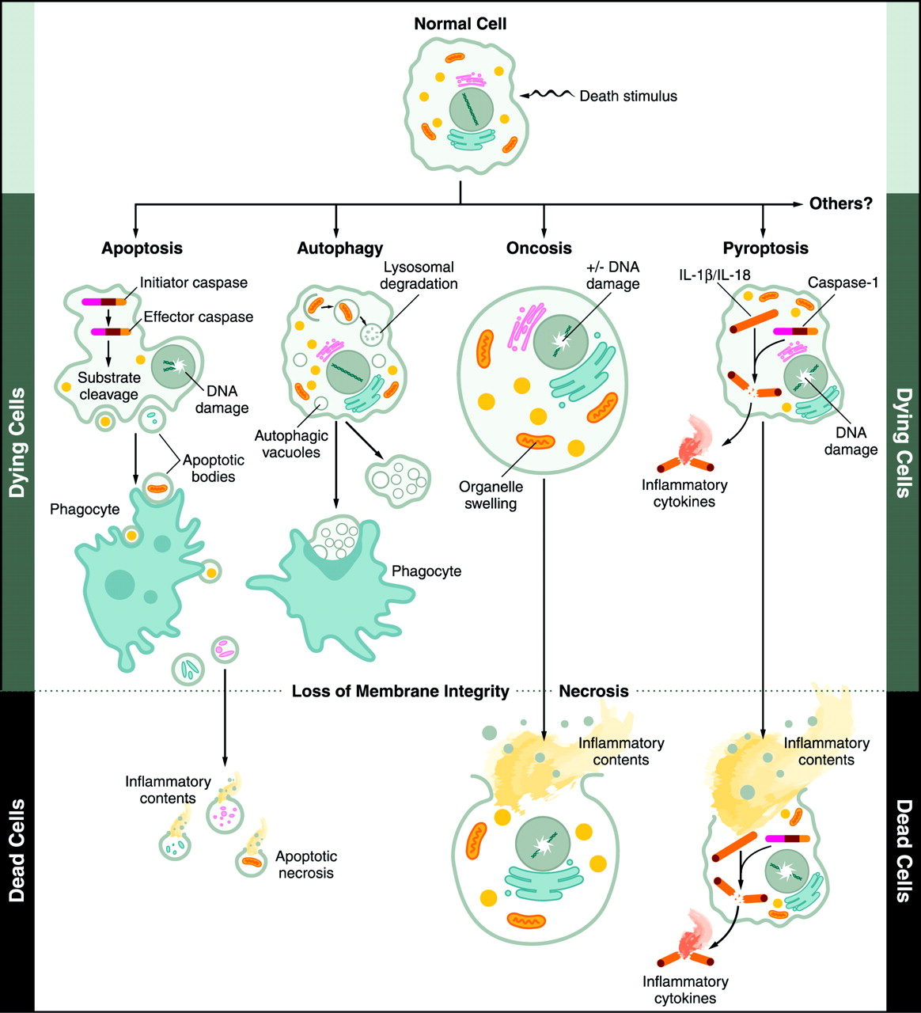
Notes:
Figure 2.5: Schematic shows how a normal cell may receive signals that trigger cell death by several controlled biochemical pathways resulting in apoptosis, autophagy, necroptosis (which include oncosis and pyroptosis), or the uncontrolled disruptive necrosis pathway.

Slide 7
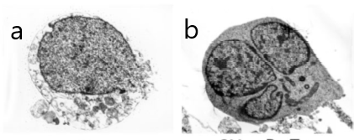
Notes:
Figure 2.6: Electron micrographs of cell death occurring by apoptosis (a), necrosis (b), autophagy or necroptosis.
From Fink and Cookson in Infection and Immunity (2005) 73: 1907-1916.

Slide 8
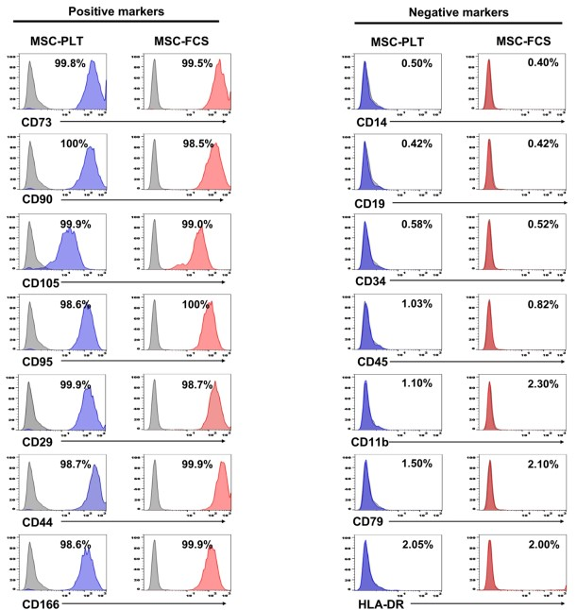
Notes:
Figure 2.7: FACS identifies cells (here MSCs grown in PLT (platelet lysate) or FCS (fetal calf serum)) that bind positively (greater that 99%) with antibodies against surface molecules on cells versus those that do not bind (less than 2.5 %) to MSCs.
From Global phenotypic characterization of human platelet lysate expanded MSCs by high-throughput flow cytometry, Reis et al., 2018, Scientific Reports 8;1-12.

Slide 9
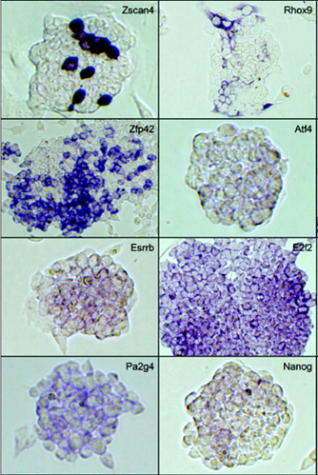
Notes:
Figure 2.8: Single colonies of stem cells may show differences in gene expression even among recent daughter cells within a single colony. Here each group of cells was probed with an RNA probe for the gene shown in the upper right of each pane.
From Carter et al., Gene Expression Patterns 8, 2008, 181–198.

Slide 10
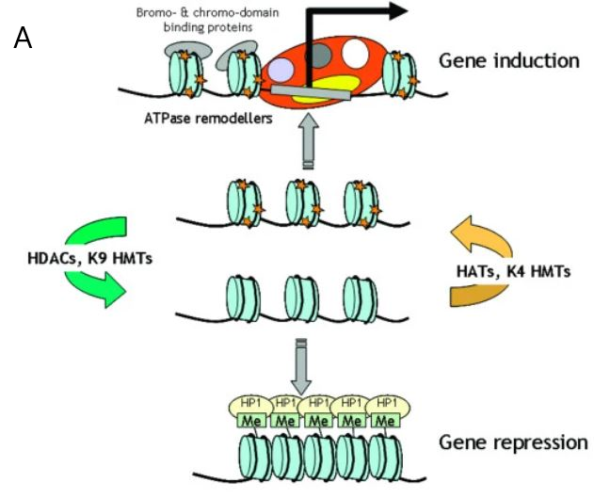
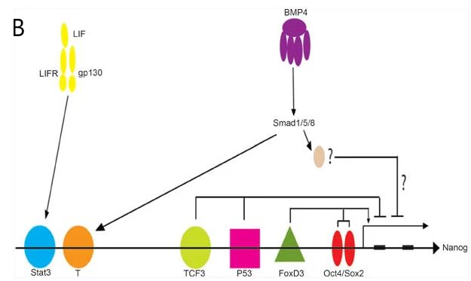
Notes:
Figure 2.9: Targeted DNA modifications at gene regulatory regions (A) under the control of histone methylases (HMTs), histone acetyltransferases (HATs) and histone deacetylases (HDACs). B) the nuclear cell signalling events that must occur to turn on transcription of the stem cell Nanog gene is depicted.
From Adcock, I.A., Ford, P., Ito, K. and Barnes, P.J., 2006, Respiratory Research 7: 21.

Slide 11
Notes:
Figure 2.10: Overview of library preparation methods for different RNA-sequencing (RNA-seq) methods.
From RNA sequencing: the teenage years, Stark, R. et al., Nat Rev Genet 20, 631–656, 2019, https://doi.org/10.1038/s41576-019-0150-2.

Slide 12
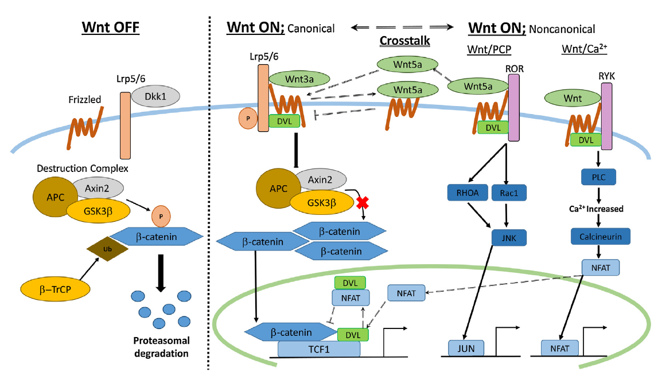
Notes:
Figure 2.11: Wnt pathways.
From Nagano, 2019, Japanese Dental Science Review 55:80-87.

Slide 13
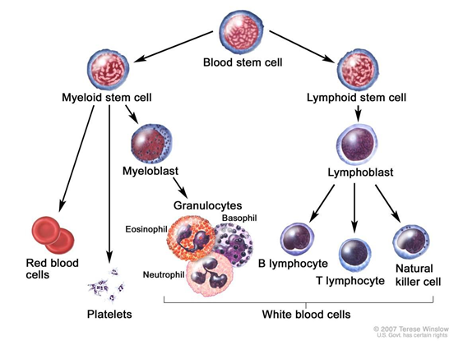
Notes:
Figure 2.12: Hematopoietic stem cells from bone marrow regenerate all of the adult blood cell lineages.
From NIH website www.NIH.gov/hematopoietic stem cells.

Slide 14
Notes:
Figure 2.13: Characteristics of mesenchymal stem/stromal cells.
From Pittenger et al., 2019, NPJ Regenerative Medicine 4:22-37.

Slide 15
Notes:
Figure 2.14: Immunomodulatory capacity of MSCs to escape rejection by immune cells.
From Pittenger et al., 2019, NPJ Regenerative medicine 4:22-37.

Slide 16
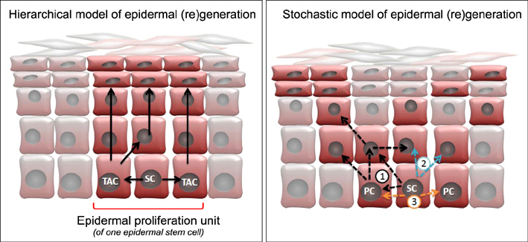
Notes:
Figure 2.15: Modes of skin regeneration by skin stem cells (SC).
From Current and Future Perspectives of Stem Cell Therapy in Dermatology, Prodinger CM, Reichelt J, Bauer JW, Laimer M., 2020, Annals of Dermatology 29:667-687.

Slide 17
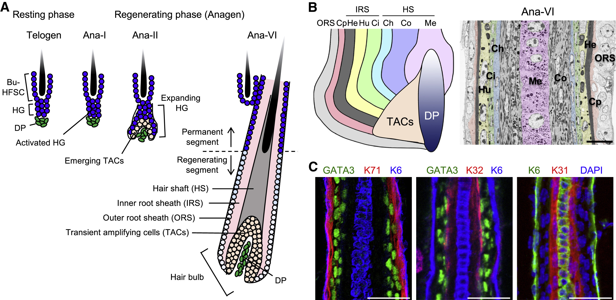
Notes:
Figure 2.16: The hair follicles regenerates throughout life and their structure are complex.
From Epithelial-Mesenchymal Micro-niches Govern Stem Cell Lineage Choices, Yang H, Adam RC, Ge Y, Hua ZL, Fuchs E., 2017, Cell 169; 483–496.

Slide 18
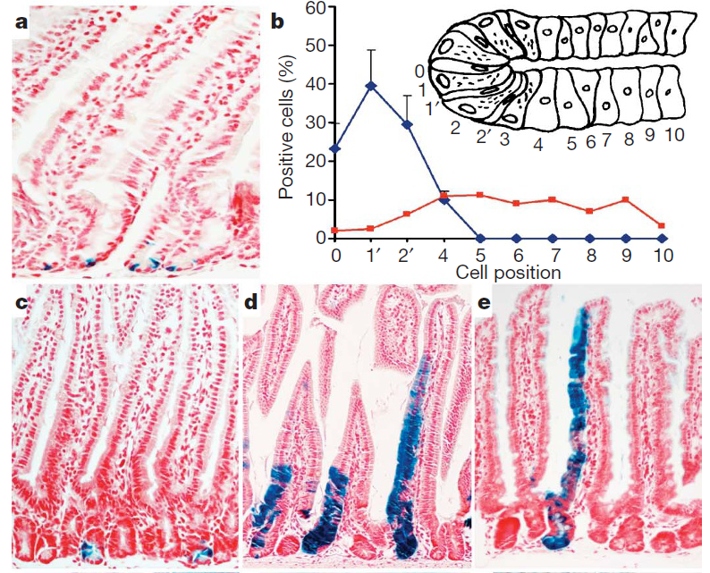
Notes:
Figure 2.17: The intestinal microvilli have LGR5 expressing stem cells at the crypt base which become absorptive cells and migrate towards the tip where they are sloughed off through normal use.
From Identification of stem cells in small intestine and colon by marker gene Lgr5, Barker, N., van Es, J., Kuipers, J. et al. Nature 449, 1003–1007, 2007, https://doi.org/10.1038/nature06196.

Slide 19
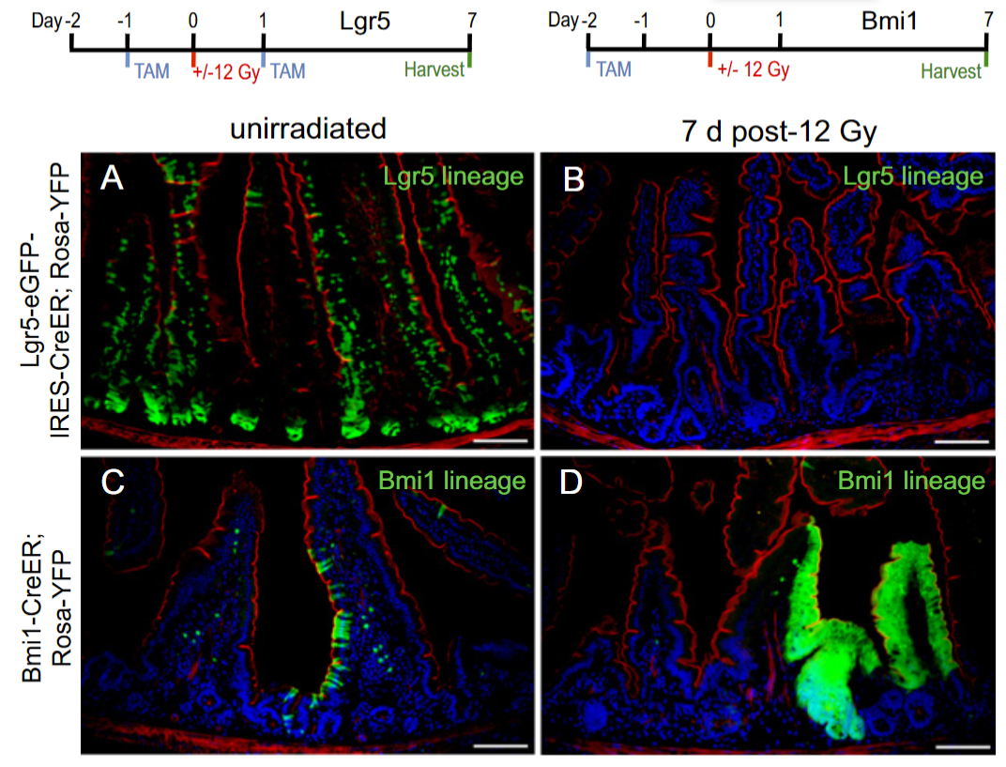
Notes:
Figure 2.18: The intestinal crypt provides two populations of stem cells that are active in regenerating the villi. Normally, Lgr5 expressing cells are the most active (green cells in A), while Bmi1 cells provide only a small contribution (green cells in C), but if Lgr5 cells are ablated (B), the Bmi1 cells contribute strongly to villus maintenance (D).
From The intestinal stem cell markers Bmi1 and Lgr5 identify two functionally distinct populations, Yan, Chia, Li, Ootani et al., 2012, Proc. Nat. Acad. Sci.109:466-471.

Slide 20
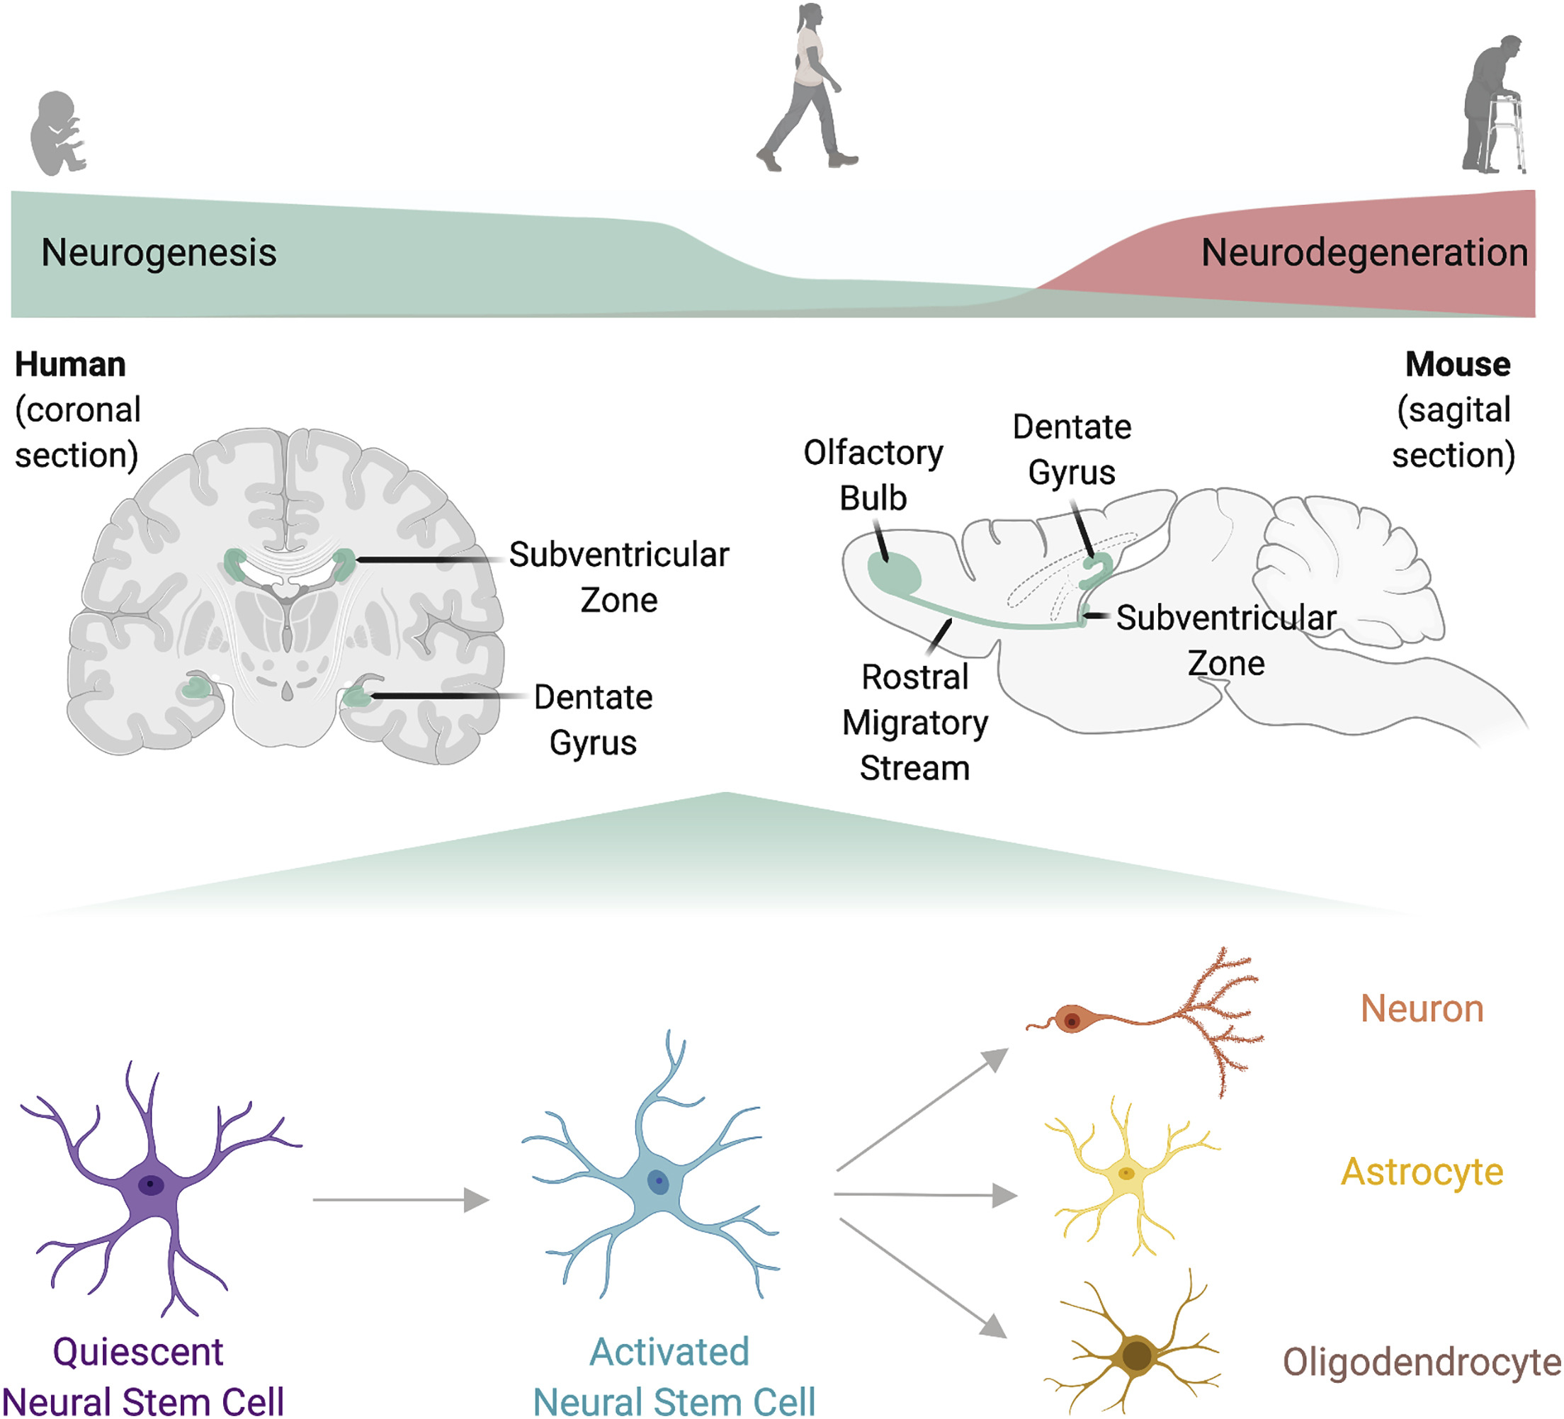
Notes:
Figure 2.19: Neural stem cells propagate during early development but are only found in a few brain sites in the brain during adulthood, and there is only a little central nervous system repair late in life.
From Aging and Rejuvenation of Neural Stem Cells and Their Niches, Negredo et al., 2021, Cell Stem Cell 27: 202-223.

Slide 21
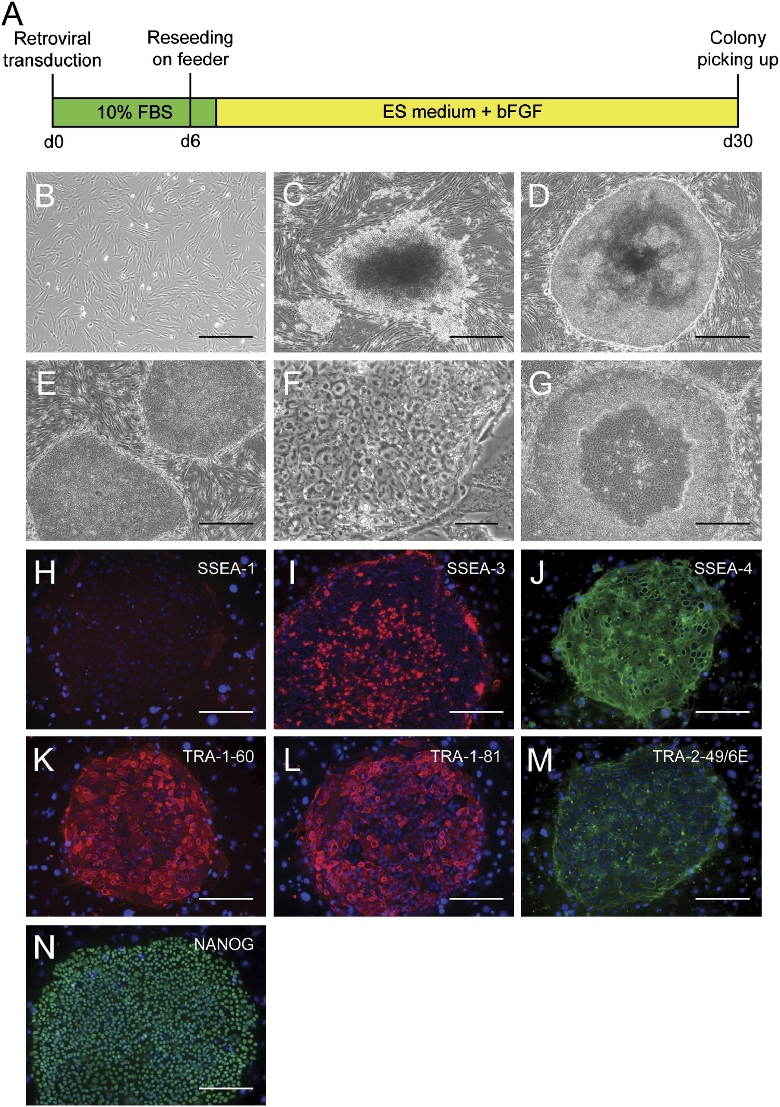
Notes:
Figure 2.20: Reprogramming of adult fibroblasts to induced pluripotent stem cells (iPS Cells).
From Induction of Pluripotent Stem Cells From Adult Human Fibroblasts by Defined Factors, Takahashi et al., Cell 131;1-12.

Slide 22
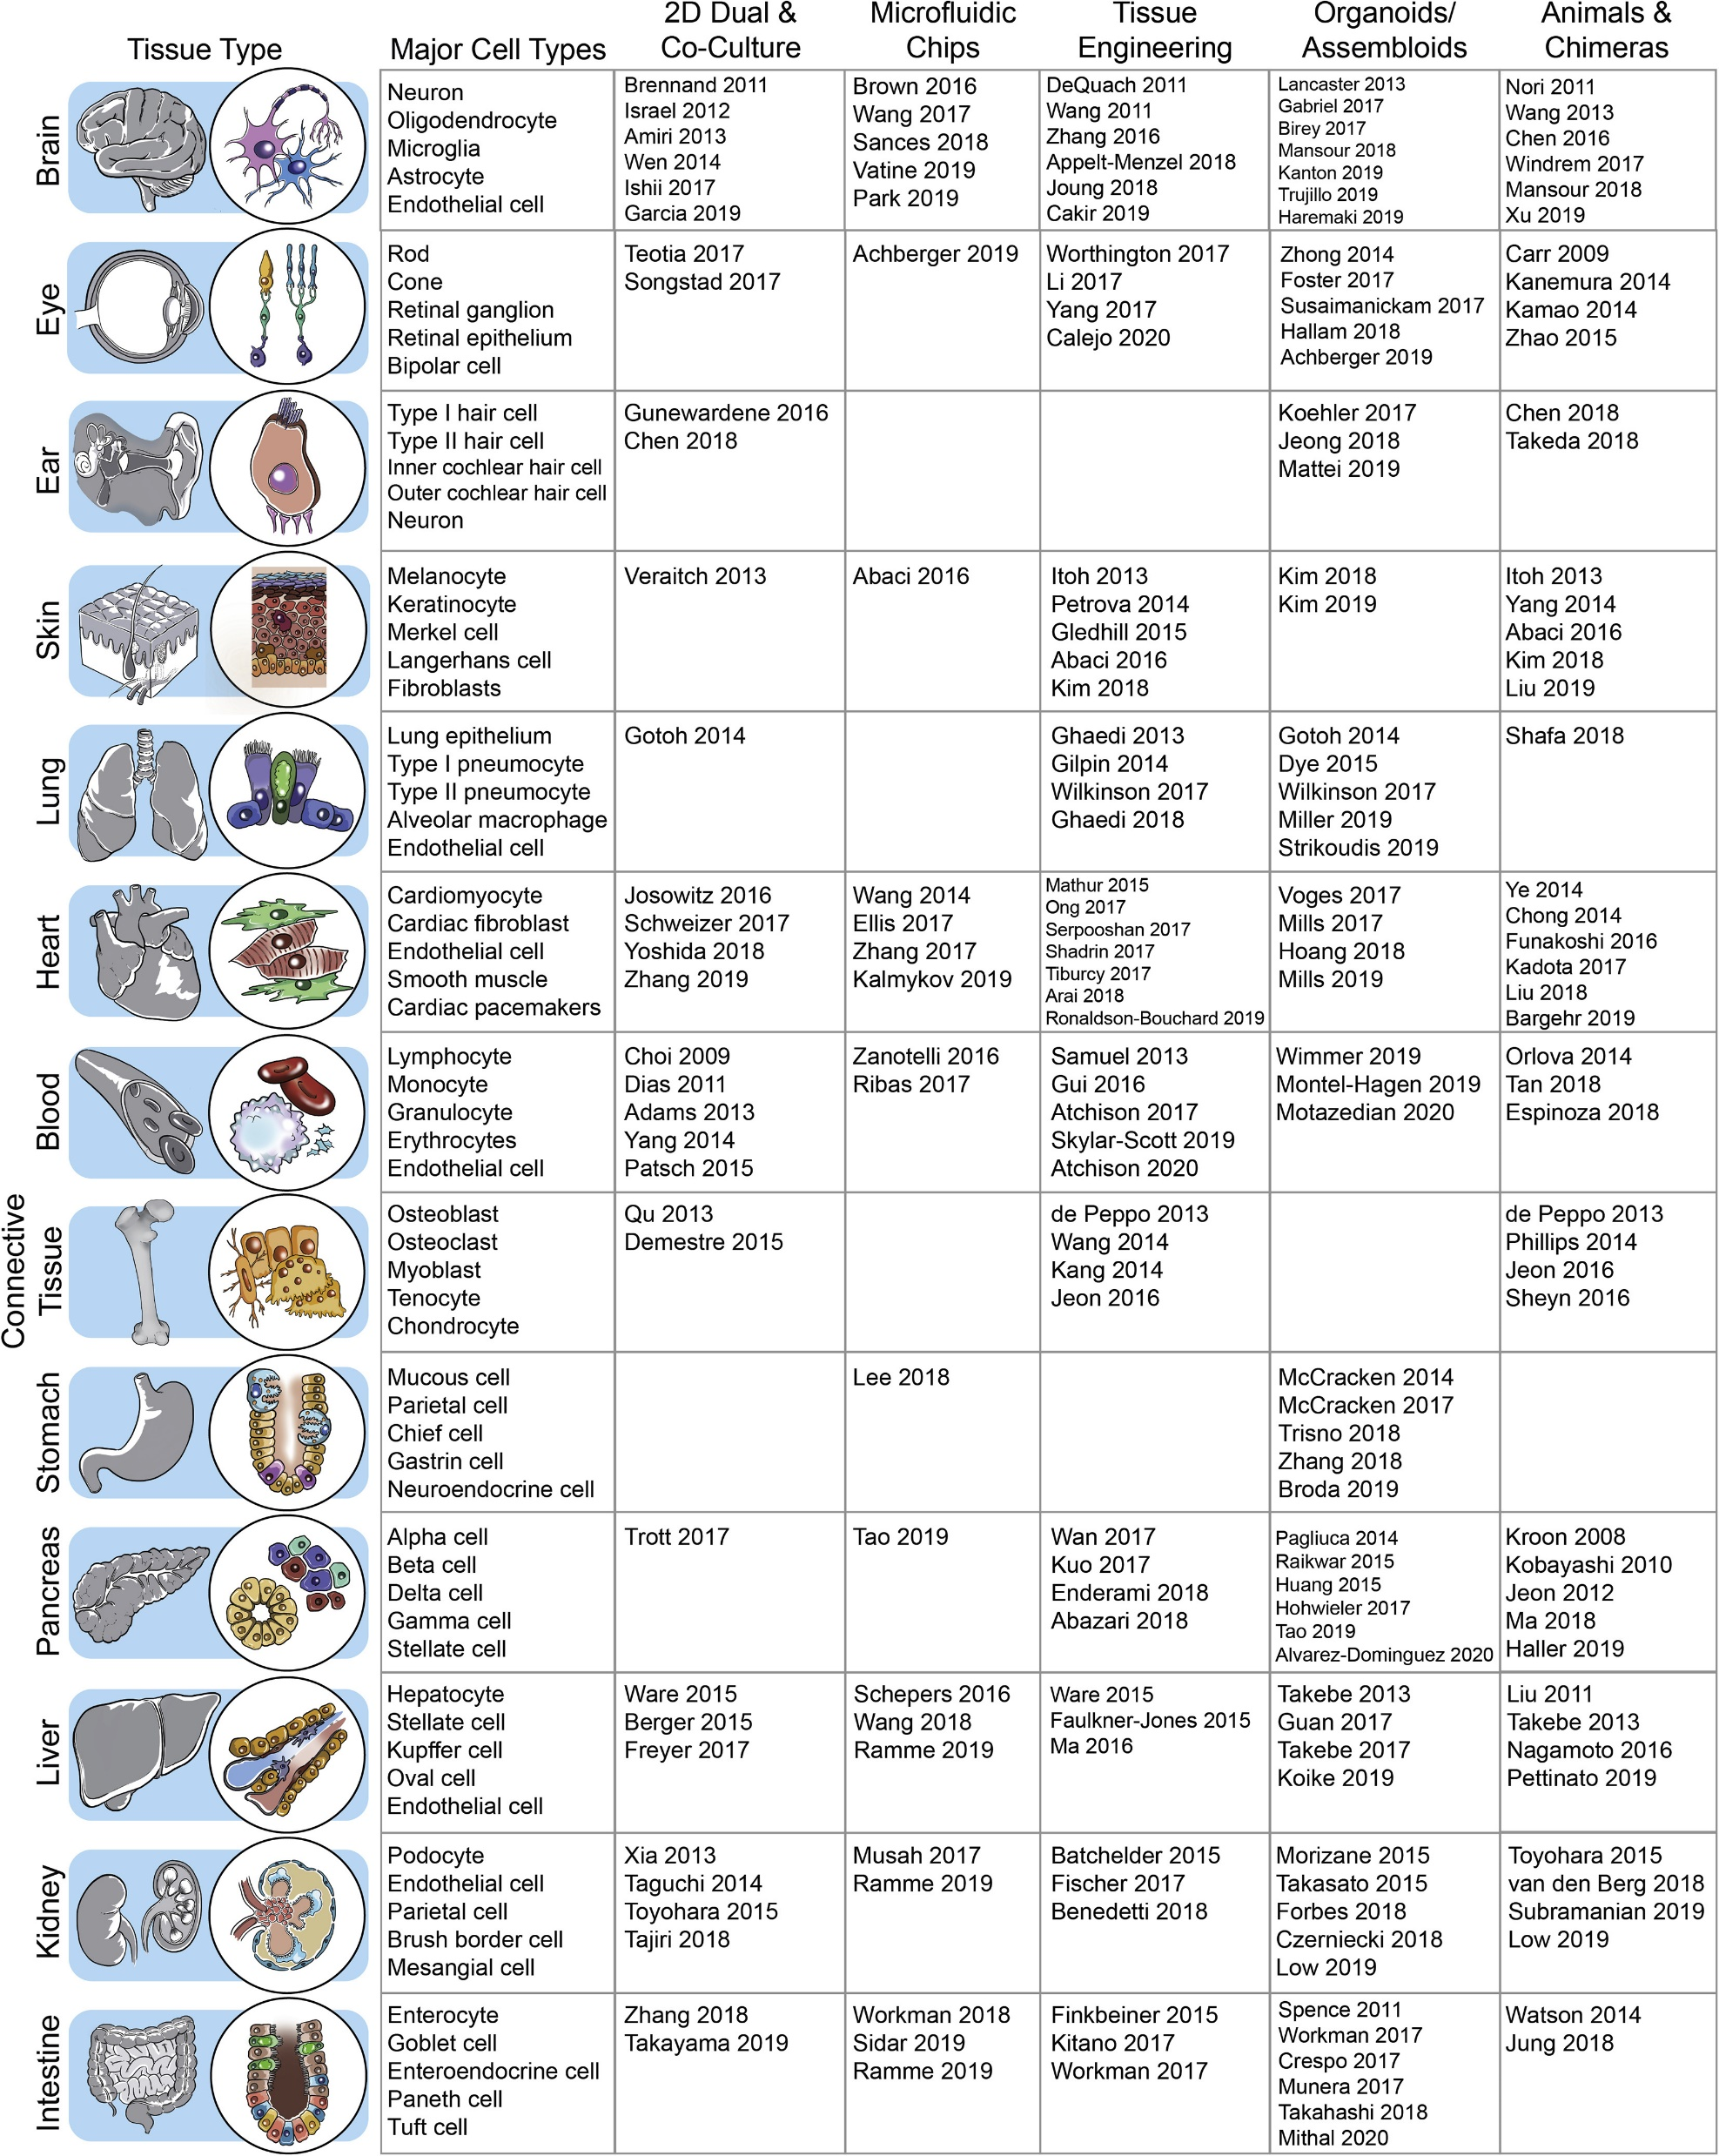
Notes:
Figure 2.21: Human iPSCs can form multilineage model systems of development and disease for a variety of somatic tissues.
From Multi-lineage Human iPSC-Derived Platforms for Disease Modeling and Drug Discovery, Sharma A, Sances S, Workman MJ, Svedsen CN, 2020, Cell Stem Cell 26: 309-329.

Slide 23
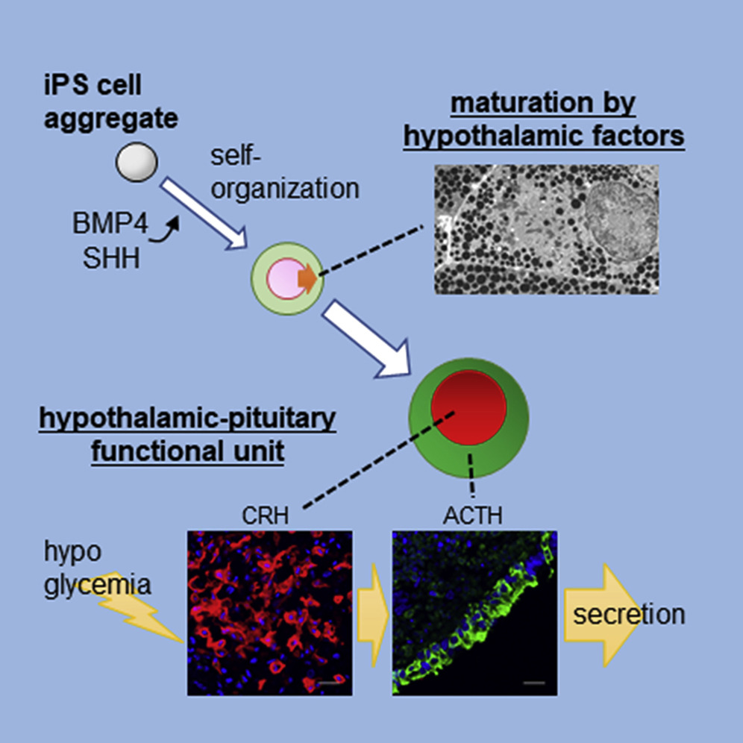
Notes:
Figure 2.22: iPS cell aggregates differentiated to release hormones such as CRH and ACTH.
From Hypothalamic Contribution to Pituitary Functions Is Recapitulated In Vitro Using 3D-Cultured Human iPS Cells, Kasai et al., 2020, Cell Reports 30, 18–24.

Slide 24

Notes:
Figure 2.23: This is the northern white rhino, and the last male died in 2018. Now researchers are planning to use his frozen skin cells to create iPS cells that may then be used to create a new embryo that can develop after implantation in a surrogate mother.
From Vertigo_Warrior. The end of an era. Twitter.com https://twitter.com/VertigoWarrior/status/1399988901750599681 (2021).

Slide 25
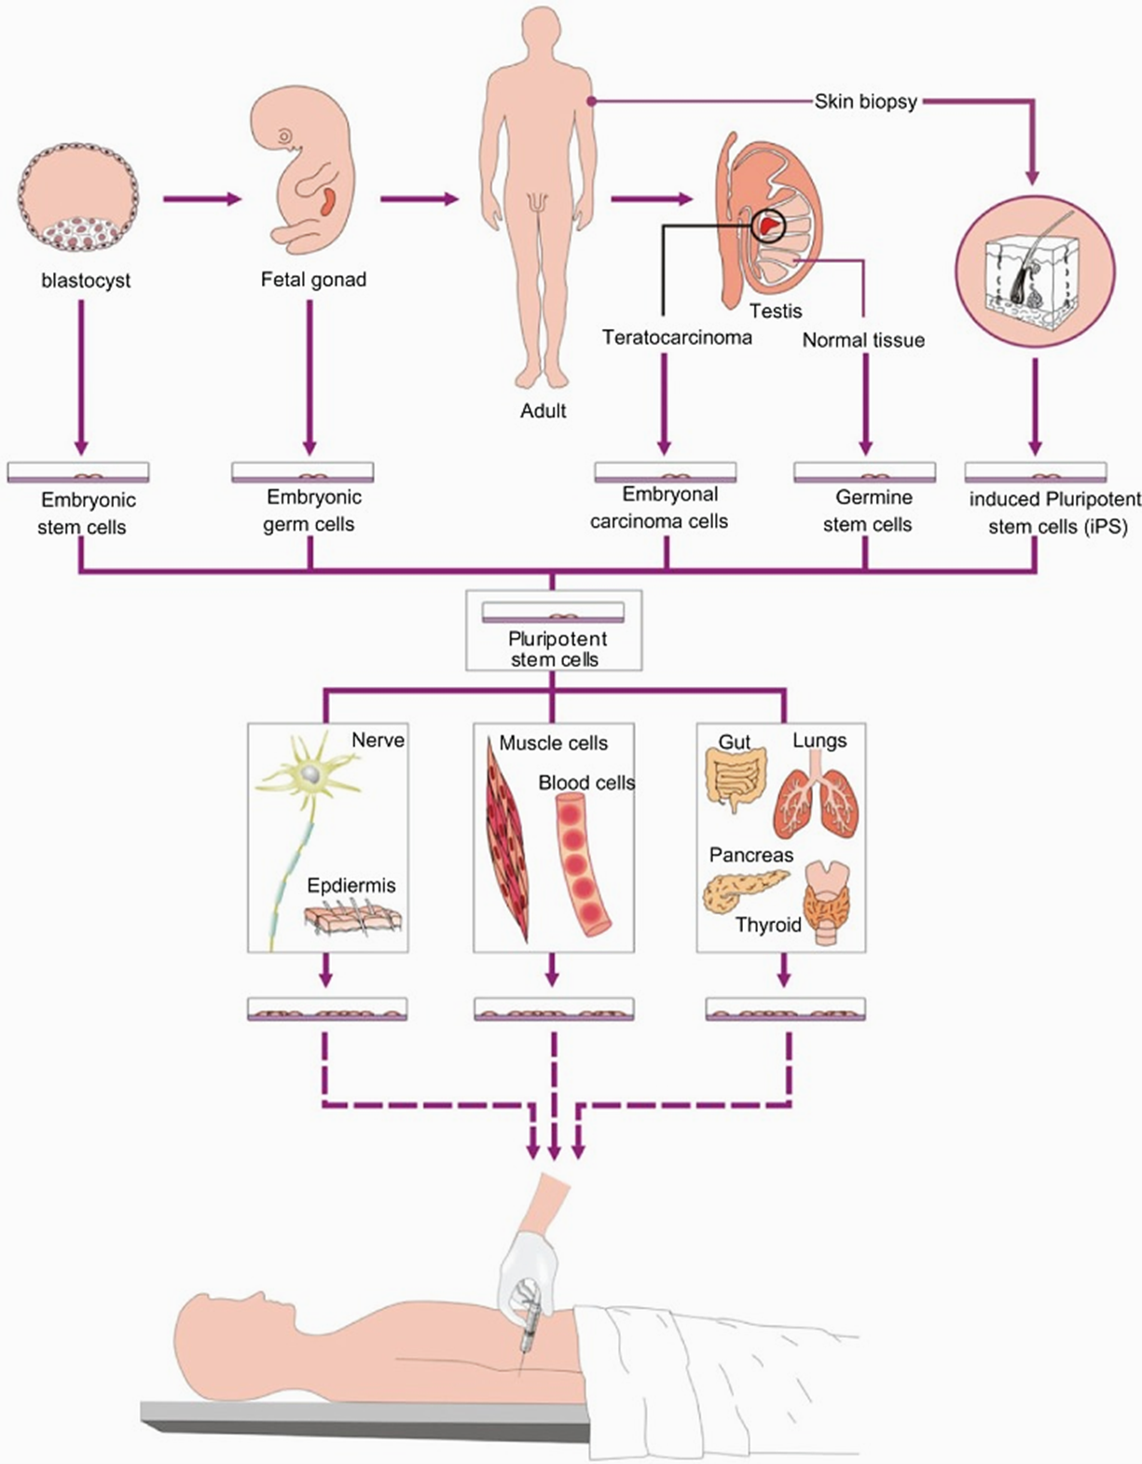
Notes:
Figure 2.24: Sources of pluripotent stem cells for therapeutic use.
From Stem Cells and Cloning: Advances and Applications, Swelstad and Kerr, 2010, 3:13-27.

Slide 26
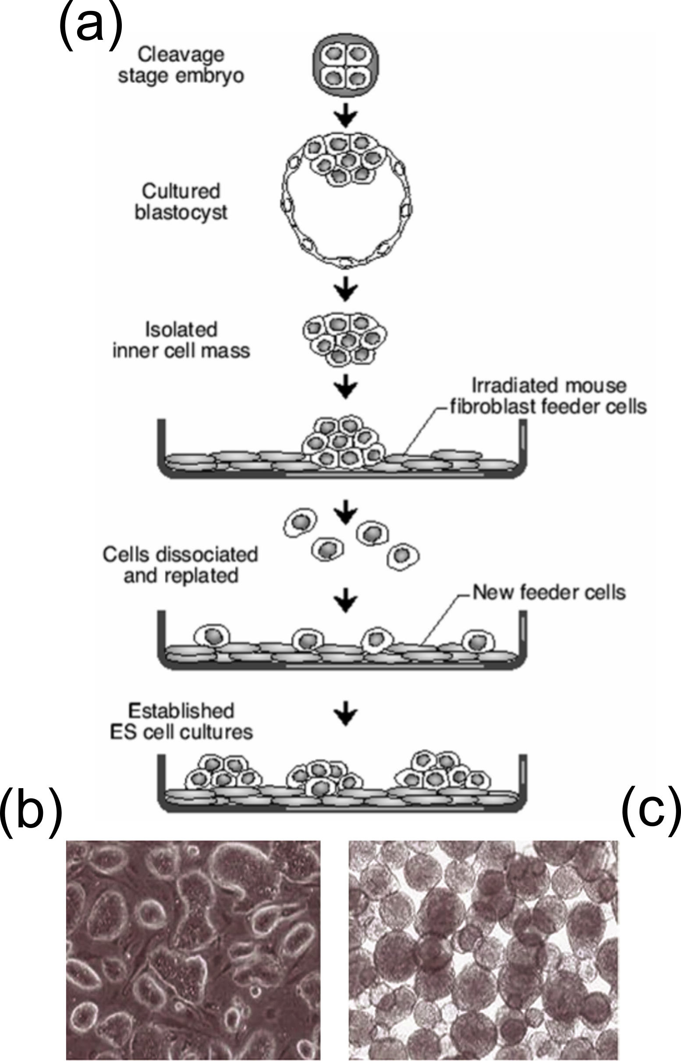
Notes:
Figure 2.25: Embryonic stem cell derivation method and cultivation. A) Diagram of derivation of embryonic stem cells. B) colonies growing on a dish or C) free-floating colonies.

Slide 27
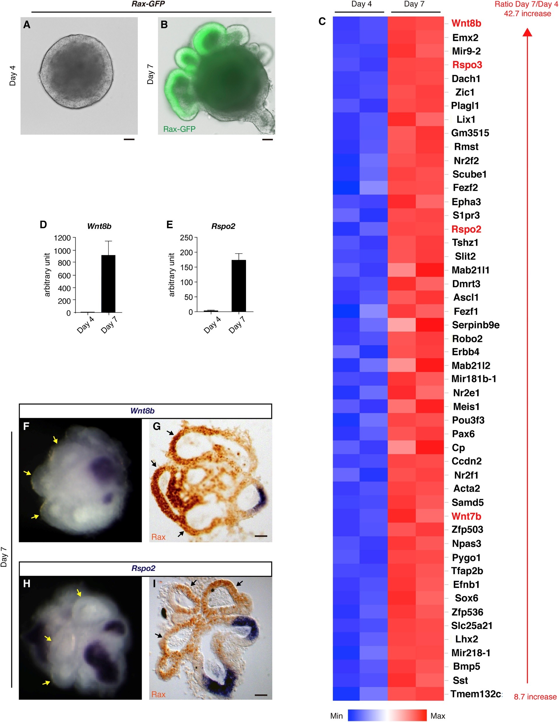
Notes:
Figure 2.26: Organoid culture and ES cell differentiation to optic cells. Organoid culture of ESCs transduced with GFP under control of the retinal homeobox gene Rax promoter sequence analyzed at 4 and 7 days of optic cell differentiation.
From Takata et al., 2017, Cell Reports 21:1534-1549.

Slide 28
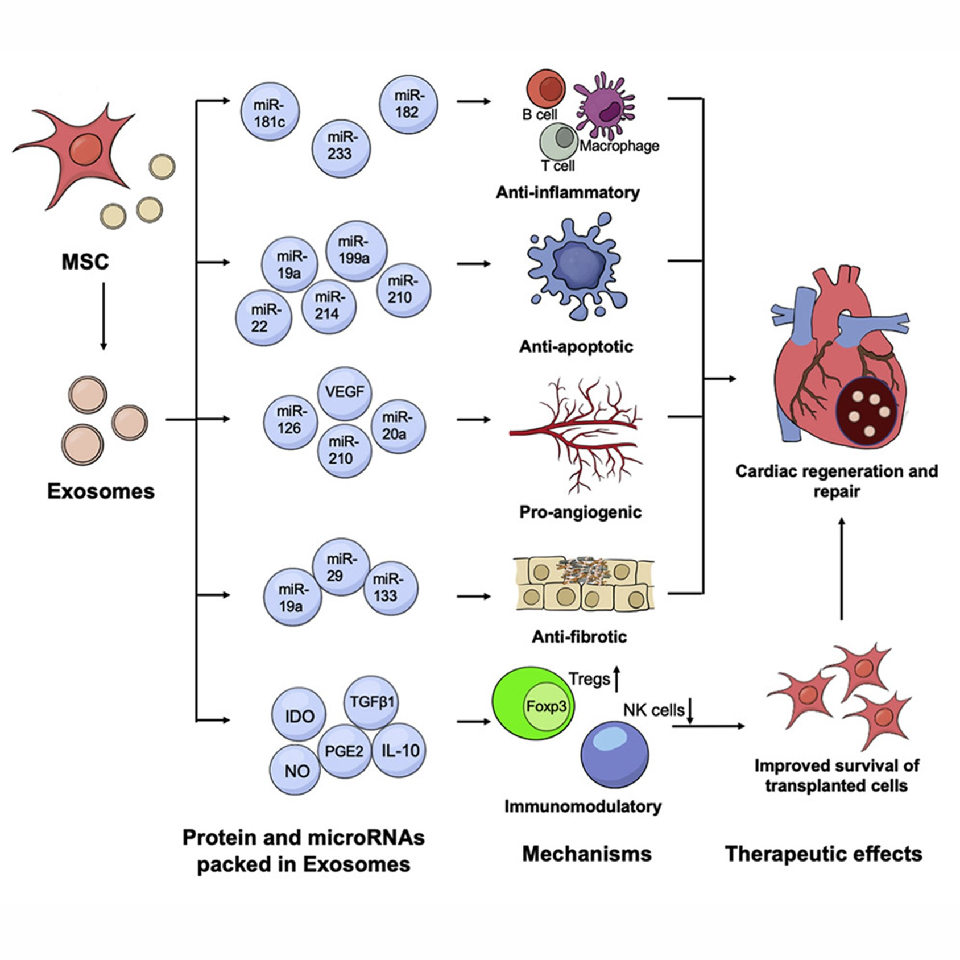
Notes:
Figure 2.27: Exosomes produced by MSCs, and other stem cells can carry proteins, microRNAs and metabolites to nearby cells or over great distances to effect changes in other tissues.
From Mesenchymal stromal cell-derived exosomes in cardiac regeneration and repair, Sun et al., 2021, Stem Cell Reports 16: 1662–1673.

Slide 29
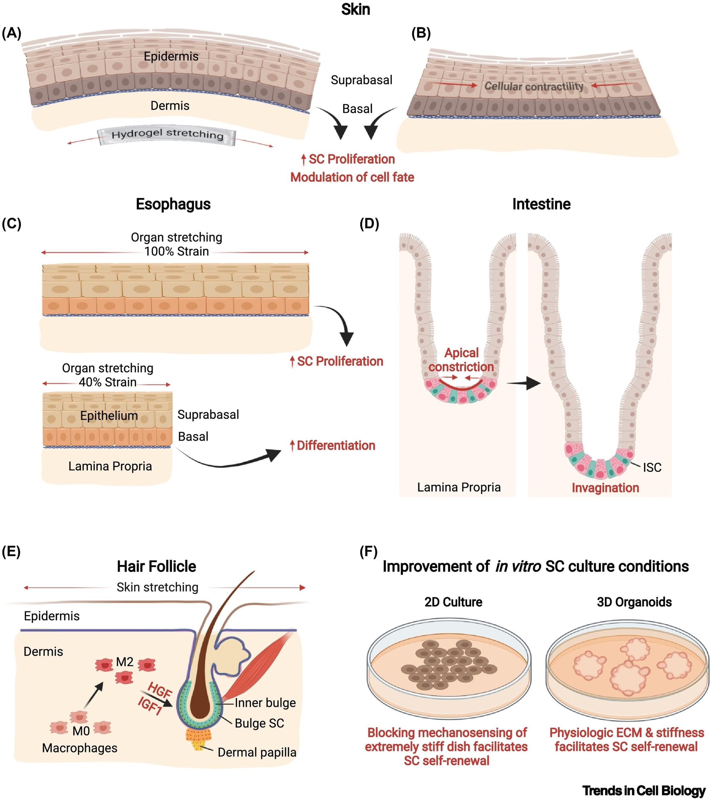
Notes:
Figure 2.28: Stem cells are continuously monitoring their environment and do respond to mechanical stimulation as well as cytokines and growth factors. The cells' actin and tubulin cytoskeletons are connected to the extracellular matrix as well as the cell nucleus and stimulation often results in proliferation.
From Stem cell responses to stretch and strain, Bhattacharya S, Wolfenson H, Shivdasani R, Shalom-Feuerstein R, 2022, Trends in Cell Biology 32; 4-7.

Slide 30
Notes:
Figure 2.29: Intravital imaging of cancer stem cell dynamics. The mice are genetically engineered with a confetti cassette that results in expression of one color per tumor cell following brief treatment with tamoxifen. Individual colonies then grow from those tumor cells and can be imaged by intravital microscopy. Over two weeks, some cancer cell clones continued to grow (red), grew then regressed (blue), were delayed in their growth (yellow) or never grew (green).
From Intravital imaging of cancer stem cell plasticity in mammary tumors, Zomer et al., Stem Cells, 2013 Mar;31(3):602-6. doi: 10.1002/stem.1296. PMID: 23225641; PMCID: PMC3744756.

Slide 31
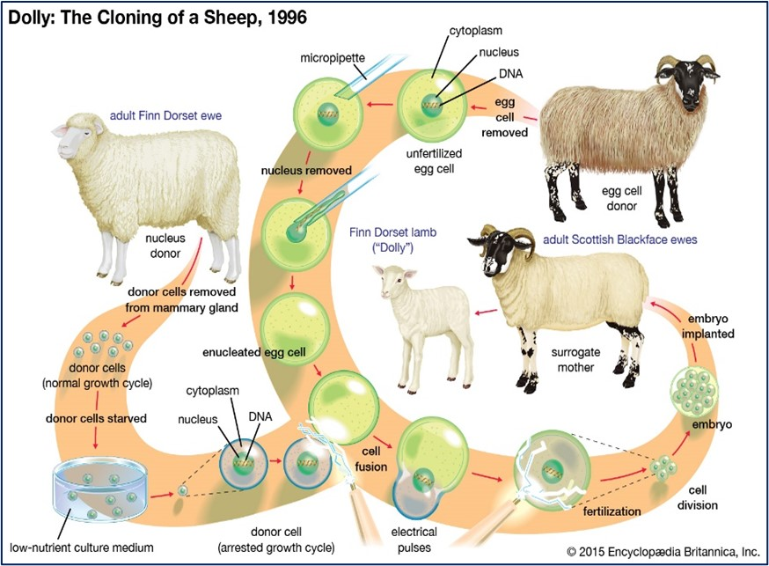
Notes:
Figure 2.30: The process of Dolly, a female Finn-Dorset sheep, resulting in the world’s first succesfully cloned mammal in 1996.
From Judith L. Fridovich-Keil. Dolly the sheep; cloning. Encyclopædia Britannica https://www.britannica.com/topic/Dolly-cloned-sheep#/media/1/866570/60421 (2021).

Slide 32
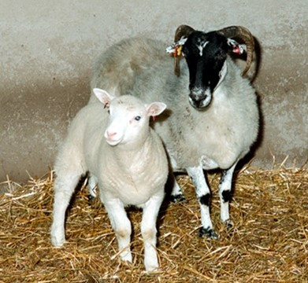
Notes:
Figure 2.31: Dolly and the egg cell donor.
From Roslin Institute. Dolly and her surrogate mother. The life of Dolly https://dolly.roslin.ed.ac.uk/facts/the-life-of-dolly/index.html.

Slide 33
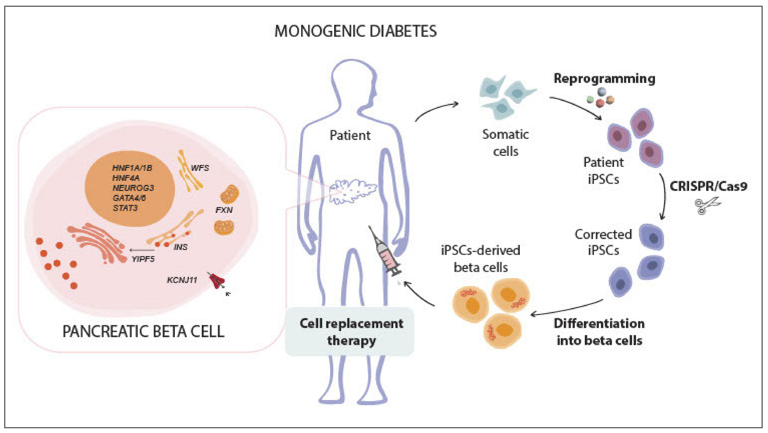
Notes:
Figure 2.32: The promising technique of using engineered human iPSC-derived beta cells for monogenic diabetes.
From Towards a functional cure for diabetes using stem cell-derived beta cells: Are we there yet?, Bourgeois S. et al. Cells 2021, 10, 191. 1-24. https://doi.org/10.3390/cells10010191.

